Slide 1

Using Postgresql To Enable Google Like Search
A copy of the presentation can be found at:https://github.com/jcriddle4/Full-Text-Presentation
Presented by: Jay Riddle
jcriddle4@yahoo.com

Slide 2

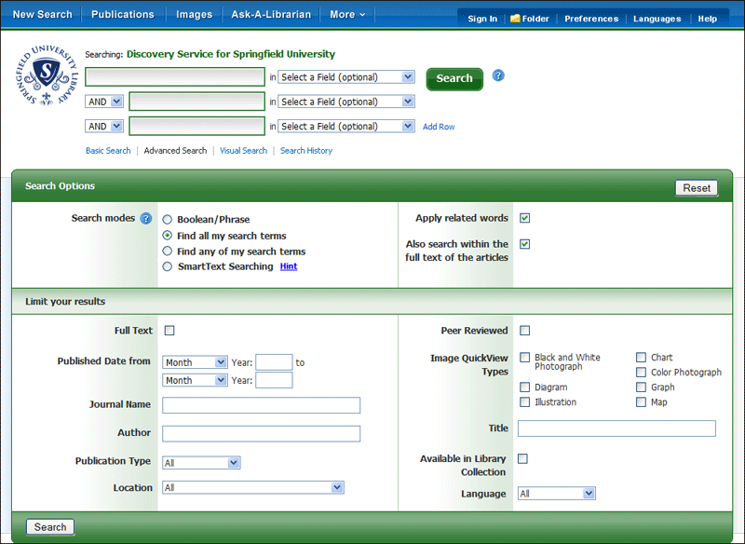
Versus

Slide 3
Like Full Text(demo)
SELECT * FROM books WHERE ILIKE '%zoo%';
SELECT * FROM books WHERE ts @@ TO_TSQUERY('zoo:*');

Slide 4
Like Full Text Differences(demo)
/* The word 'and' is a stop word so it is not * indexed.
*/
SELECT * FROM books WHERE ILIKE '% and %';
SELECT * FROM books WHERE ts @@ TO_TSQUERY('and');
Notes:
“and” is a “stop word”.
“A document is the unit of searching in a full text search system”

Slide 5
Full Text Includes Numbers(demo)
SELECT * FROM books WHERE ts @@ TO_TSQUERY('123');
Notes:
“and” is a “stop word”.
“A document is the unit of searching in a full text search system”

Slide 6
Full Text Index Performance Versus Regular Index
ID | First_Name | Last_Name
12345 | Arthur Conan | Doyle
Example: Start with a table with three normal indexes on columns ID, First_Name and Last_Name. On an insert we expect,roughly speaking, three spots in the indexes to be updated.

Slide 7
Full Text Index Performance Versus Regular Index
… | Biography
 | Scottish physician and writer noted for detective Sherlock Holmes and Dr. Watson and a lesser known Professor Challenger.
Example: A table with a full text index. On insert we expect,roughly speaking, a update to the index per lexeme. In this example there are 13 lexemes.

Slide 8
Index creation speeds(demo)
/* Full text indexes(type GIN) are getting
* faster in Postgresql 9.4
*/
DROP INDEX idx_reviews_full_text;
DROP INDEX idx_reviews_isbn;
-- This is a regular index
CREATE INDEX idx_reviews_isbn ON reviews (isbn);
-- This is a GIN index
CREATE INDEX idx_reviews_full_text ON reviews USING GIN(ts);
Notes:
--58..60 seconds
Full text 58..60 seconds
Normal index 1.1 second

Slide 9
Performance - FASTUPDATE
Postgresql gets around some of the performance costs associated with the GIN index by putting insert\update data into a temporary unsorted list of pending entries. This allows a background process to use bulk insert techniques to speed updates.
The downside to this is that searches must scan the pending entries in addition to searching the index. If the pending list becomes too large it can slow search significantly. FASTUPDATE can be disabled.

Slide 10
Ranking Results(demo)
/* You can use the built in ranking but you may * find, for your application, a * ORDER BY <some columns> is a better fit. */
SELECT TS_RANK_CD(ts, query) as rank
, bk.*
FROM books bk
, TO_TSQUERY('adams & hitch:*') query
WHERE query @@ ts
ORDER BY rank DESC
Notes:
--58..60 seconds
Full text 58..60 seconds
Normal index 1.1 second

Slide 11
Highlighting Results(demo)
/* NOTE PERFORMANCE: If we use LIMIT and TS_RANK
* we may end up making expensive calls to * TS_HEADLINE() for rows that are not returned. * If this is the case then use a subquery first. */
SELECT TS_RANK_CD(ts, query) as rank
, TS_HEADLINE(document,query) as headline
, bk.*
FROM books bk
, TO_TSQUERY('adams & hitch:*') query
WHERE query @@ ts
ORDER BY rank DESC
Notes:
--58..60 seconds
Full text 58..60 seconds
Normal index 1.1 second

Slide 12
Keeping your tsvector column synchronized(option 1)
/* NOTE PERFOMANCE: The built in full text * triggers always update the tsvector column
* even if the columns changed are not included. */
CREATE TRIGGER tsvectorupdate BEFORE INSERT OR UPDATE ON books FOR EACH ROW EXECUTE PROCEDURE
tsvector_update_trigger(ts
, 'pg_catalog.english'
, isbn, book_title, book_author, publisher);
Notes:
--58..60 seconds
Full text 58..60 seconds
Normal index 1.1 second

Slide 13
Keeping your tsvector column synchronized(option 2)
/* Here is a example of only updating the tsvector when needed. Notice the
* use of STRIP(). The STRIP() function removes the position information
* from the tsvector. STRIP() saves table space but not index space.
*/
CREATE OR REPLACE FUNCTION func_sync_full_text_column()
RETURNS trigger AS
$BODY$
BEGIN
NEW.ts = STRIP(
TO_TSVECTOR(
CONCAT(NEW.book_title,' ',NEW.book_author,' ', NEW.publisher)
));
RETURN NEW;
END;
$BODY$
LANGUAGE plpgsql VOLATILE
CREATE TRIGGER tr_full_text_sync
BEFORE UPDATE
ON books
FOR EACH ROW
WHEN ((coalesce(OLD.book_title,'') <> coalesce(NEW.book_title,''))
OR (coalesce(OLD.book_author,'') <> coalesce(NEW.book_author,''))
OR (coalesce(OLD.publisher,'') <> coalesce(NEW.publisher,'')))
EXECUTE PROCEDURE func_sync_full_text_column();
Notes:
--58..60 seconds
Full text 58..60 seconds
Normal index 1.1 second

Slide 14
Users Querying Full Text
Is this level of complexity in the query syntax workable for your users?
Search: | Douglas & Hitch:*
Notes:
--58..60 seconds
Full text 58..60 seconds
Normal index 1.1 second

Slide 15
Function: plainto_tsquery() Almost Works(demo)
/* Note: The function plainto_tsquery()
* ignores wildcards.
*/
select *
from books
where ts @@ plainto_tsquery('douglas & hitch:*')
Notes:
--58..60 seconds
Full text 58..60 seconds
Normal index 1.1 second

Slide 16
Rolling Your Own Full Text Query Builder Example
/* PERFOMANCE: The very last part of this function, where it is of type
* STABLE, is very important for performance if used directly in a query.
* Note: Rolling your own parser has the advantage of allowing exceptions say
* if the user enters a number treat it as a order number.
*/
CREATE OR REPLACE FUNCTION do_full_text(search_terms text)
RETURNS text AS
$func$
DECLARE
new_term text;
search_array text[];
BEGIN
new_term := regexp_replace(search_terms,'[^a-zA-Z0-9]',' ','g');
-- Remove any duplicate spaces
new_term := regexp_replace(search_terms,'\s+',' ','g');
search_array := string_to_array(new_term,' ');
FOR i IN 1..array_length(search_array,1) LOOP
search_array[i] := CONCAT(search_array[i],':*');
END LOOP;
new_term := array_to_string(search_array,' & ');
RETURN new_term;
END;
$func$
LANGUAGE plpgsql STABLE;
Notes:
--58..60 seconds
Full text 58..60 seconds
Normal index 1.1 second

Slide 17
Querying Multiple Tables with Full Text
Do queries need to return data that was just entered?
How much data are you working with?
How often is data changing in the tables you are querying?

Slide 18
Multiple Tables: Option 1
/* In this example we are building a document table that brings
* together our books and reviews tables:
*
* PROS: Querying is much simpler(see later example)
*
* CONS: The document table will not be current and will need * to be refreshed.
*/
INSERT INTO document(isbn,book_title,ts)
SELECT bk.isbn
, bk.book_title
, to_tsvector(concat(
bk.book_title ,' '
,bk.book_author ,' '
,bk.publisher, ' '
,(
SELECT string_agg(rv.comment, ' ')
FROM reviews rv
WHERE bk.isbn = rv.isbn
))) AS ts
FROM books bk
Notes:
--58..60 seconds
Full text 58..60 seconds
Normal index 1.1 second

Slide 19
Multiple Tables: Option 2
/* In this example we are leaving the data with the table:
*
* PROS: The data is left on the table. The query will see the latest data.
*
* CONS: Querying is much more complex and for multiple terms will require dynamic sql.
*
* PERFORMANCE NOTE: The query uses IN instead of EXISTS because EXISTS is very slow.
*/
SELECT *
FROM books bk
WHERE bk.isbn IN --First query term
(
SELECT bk2.isbn
FROM books bk2
WHERE bk2.ts @@ to_tsquery('adams:*')
UNION
SELECT rv.isbn
FROM reviews rv
WHERE rv.ts @@ to_tsquery('adams:*')
)
AND bk.isbn IN --Second query term
(
SELECT bk2.isbn
FROM books bk2
WHERE bk2.ts @@ to_tsquery('hitch:*')
AND bk.isbn = bk2.isbn
UNION
SELECT rv.isbn
FROM reviews rv
WHERE rv.ts @@ to_tsquery('hitch:*')
)
Notes:
--58..60 seconds
Full text 58..60 seconds
Normal index 1.1 second

Slide 20
Multiple Tables(Next Slide for readable source code): Option 3A
/* In this example we use a consolidated document table
* but use triggers to keep the table updated:
*
* PROS: The document table is kept updated.
*
* CONS: Triggers can be very evil.
*
*/
CREATE OR REPLACE FUNCTION func_reviews_full_text()
RETURNS trigger AS
$BODY$
BEGIN
UPDATE document
SET ts = STRIP(to_tsvector(NEW.comment)
|| (
SELECT to_tsvector(
concat(
bk.book_title ,' '
,bk.book_author ,' '
,bk.publisher, ' '
,(
SELECT string_agg(rv.comment, ' ')
FROM reviews rv
WHERE bk.isbn = rv.isbn
)))
FROM books bk
WHERE bk.isbn = NEW.isbn
))
WHERE document.isbn = NEW.isbn
AND STRIP(document.ts) <> STRIP(TO_TSVECTOR(NEW.comment) || document.ts);
RETURN NEW;
END;
$BODY$
LANGUAGE plpgsql VOLATILE
Notes:
--58..60 seconds
Full text 58..60 seconds
Normal index 1.1 second

Slide 21
Multiple Tables: Option 3A (Continued)
...
-- This update would probably be better as a
-- function for reuse.
UPDATE document doc
SET ts = STRIP(to_tsvector(NEW.comment)
|| (
SELECT to_tsvector(
concat(
bk.book_title ,' '
,bk.book_author ,' '
,bk.publisher, ' '
,(
SELECT string_agg(rv.comment, ' ')
FROM reviews rv
WHERE bk.isbn = rv.isbn
)))
FROM books bk
WHERE bk.isbn = NEW.isbn
))
WHERE doc.isbn = NEW.isbn
AND STRIP(doc.ts) <> STRIP(TO_TSVECTOR(NEW.comment) || doc.ts);
...
Notes:
--58..60 seconds
Full text 58..60 seconds
Normal index 1.1 second

Slide 22
Multiple Tables: Option 3B
...
-- This is a much simpler update but if words are removed
-- from a book title or a review this would never remove
-- them from the tsvector. We could pair this with a
-- nightly job that rebuilds all unmatching tsvectors.
UPDATE document doc
SET ts = (TO_TSVECTOR(NEW.comment) || doc.ts)
INTO bol_match
FROM document doc
WHERE doc.isbn = NEW.isbn
AND STRIP(TO_TSVECTOR(NEW.comment) || doc.ts) <> STRIP(doc.ts);
...
Notes:
--58..60 seconds
Full text 58..60 seconds
Normal index 1.1 second

Slide 23
Summary
Full Text search is great for users
Postgresql full text abilities are excellent
Dealing with multiple tables can be some extra work

